Slide 1

Proguard : Detecting Malicious Accounts in Social-Media Based Online Promotions
Malwa Institute of Technology, Indore
Rajiv Gandhi Proudyogiki Vishwavidyalaya, Bhopal (M.P.)
SUBMITTED TO :
Mr. Pratyush Sharma
(HOD, CSE Dept.)
SUBMITTED BY :
Harsh Khare (0821CS191034)
Khushi Malviya (0821CS191047)
Sourabh Pal (0821CS191088)

Slide 2
01.
02.
03.
Innovation
Literature Survey
04.
05.
Problem Defination
Problem Formulation
Methodology
Table of contents
Abstract
06.

Slide 3
07.
08
09
Algorithm
Tools & Technology
Result Analysis
10
Conclusion
Table of contents

Slide 4
Abstract
Online Social Networks involve a huge amount of people from all over the world and it has become a big part of their life. People use social networks to share their feelings, to make new friends, to set up new businesses, to connect with friends and family and what not. The Online Social Networks provides a great advantage to individuals in different ways but it also suffers with some disadvantages. There are many people who use these networks to cause harm to others by making fake accounts on these networks. For detection of such fake and genuine accounts we can use machine learning algorithms. The machine learning algorithms are applied for the prediction and classification of datasets through the different models that are prepared.

Slide 5
Abstract
It sometimes become difficult to differentiate between the results of different models and so we to use a hybrid approach of machine learning algorithm can make this task easy. In our work we compared the 4 different combinations of classification algorithms and calculated their accuracy on the dataset of an Online Social Network. We used the combination of Random Forest, Support Vector Machine, Logistic Regression, and Decision Trees. After comparing the result of each hybrid approach, we concluded that the best accuracy was obtained by combination of SVM and Logistic Regression and Neural Network. So, we proposed a model for the detection of fake account with the hybrid approach giving the best accuracy among all the combinations.

Slide 6
Innovation
Classification algorithms (Support Vector Machine, Logistic Regression, Decision Tree, Random Forest, Artificial Neural Network) can be used separately and individually.
In our system we are developing a hybrid model combining two or three machine learning models has helped in increasing the accuracy of the model and its predicative power.

Slide 7
Literature Survey
S.No. | Paper name | Author | Detection Methods
1 | Fake Account Detection on Social Media | A. Singh et al. (2021). | This paper covers a range of detection methods including machine learning, deep learning, graph-based methods, and behavior-based approaches. The authors provide an overview of the techniques, highlight their strengths and weaknesses, and suggest future research directions.
2 | Fake Social Media Account Detection: A Review of State-of-the-Art Techniques and Research Challenges | M. A. Al-Shabandar et al. (2021). | This paper covers a range of detection methods including graph-based approaches, behavioral analysis, and deep learning. The authors discuss the limitations and challenges of these techniques and suggest future research directions.

Slide 8
Literature Survey
S.No. | Paper name | Author | Detection Methods
3 | Fake Account Detection on Social Media: A Systematic Literature Review" | Y. Mao et al. (2020) | This paper covers a range of detection methods including machine learning, social network analysis, and behavioral analysis. The authors provide a systematic review of the literature, discuss the limitations of current methods, and suggest future research directions..
4 | A Review of Fake Account Detection Techniques on Social Networks | S. S. Khairnar et al. (2019). | This paper covers a range of detection methods including clustering, graph-based approaches, and machine learning. The authors provide an overview of the techniques and their performance, discuss the limitations of current methods, and suggest future research directions.

Slide 9
Problem Defination
Fake account detection refers to the process of identifying social media accounts that are created with the intention to deceive or mislead others. Fake accounts are often created for spamming, phishing, spreading misinformation, or other malicious activities.
Fake account detection involves analyzing a variety of factors related to the account, including user profile information, posting patterns, content, and network connections. Machine learning techniques can be used to analyze and identify patterns in this data that are indicative of a fake account.
The goal of fake account detection is to protect users and platforms from malicious activities by identifying and removing fake accounts. This is important for maintaining the integrity of online communities and reducing the spread of harmful content.

Slide 10
Problem Formulation
Here are five key points to formulate the fake account detection problem using machine learning:
Problem Type: The problem is a binary classification task where we aim to predict whether an account is fake or genuine.
Data Collection: We need to collect data related to user activity, behavior, and network information to train the machine learning model. This data may include profile information, posting frequency, the timing of posts, content of posts, and user engagement.
Feature Engineering: We need to process and transform the collected data into meaningful features that can be used by the machine learning algorithm. This may include techniques like text preprocessing, network analysis, and feature scaling.

Slide 11
Problem Formulation
Machine Learning Model: We need to train a machine learning model using the processed data and engineered features. Techniques like decision trees, random forests, and support vector machines can be used to build the model.
Model Evaluation: We need to evaluate the performance of the machine learning model using standard metrics such as accuracy, precision, recall, and F1 score. We can use techniques like cross-validation and hyperparameter tuning to optimize the model's performance.users and platforms from malicious activities by identifying and removing fake accounts. This is important for maintaining the integrity of online communities and reducing the spread of harmful content.

Slide 12
Methodology
The Fake Account detection is built using steps like : -
Data Extraction
Data Preprocess
Data Partition
Building a Hybrid model
Training & Testing Datasets
Evaluating for accuracy

Slide 13
Data Collection
For the model to work upon, there is a need for data collection. The dataset can be collected from various online platforms and can also be created by using Crawler. We have collected two datasets through online from well-known websites Kaggle and GitHub. But we worked on the dataset which is collected by Kaggle and in that we are using two CSV files corresponding to fake and genuine users.

Slide 14
Feature Selection
We select 6 features for our Model:
statuses_count
followers_count
friends_count
favourites_count
listed_count
lang_code

Slide 15
Hybrid Model
Fake Users
Genuine User
Data Set
Feature Extraction
Testing Dataset
Training Dataset
SVM
LR
Voting Classifier
X_train, y_pred Output
NN Classifier
Trained System
Output

Slide 16
Algorithm
Machine Learning Algorithms :-
Support Vector Machine (SVM)
Neural Network (NN)
Logistic Regression (LR)
Random Forest (RF)
Decision Tree (DT)

Slide 17

Support Vector Machine (SVM)
Support Vector Machine or SVM is one of the most popular Supervised Learning algorithms, which is used for Classification as well as Regression problems. However, primarily, it is used for Classification problems in Machine Learning.
The goal of the SVM algorithm is to create the best line or decision boundary that can segregate n-dimensional space into classes so that we can easily put the new data point in the correct category in the future. This best decision boundary is called a hyperplane.
SVM chooses the extreme points/vectors that help in creating the hyperplane. These extreme cases are called as support vectors, and hence algorithm is termed as Support Vector Machine.

Slide 18
Logistic Regression
Logistic regression is one of the most popular Machine Learning algorithms, which comes under the Supervised Learning technique. It is used for predicting the categorical dependent variable using a given set of independent variables.
Logistic regression predicts the output of a categorical dependent variable. Therefore the outcome must be a categorical or discrete value. It can be either Yes or No, 0 or 1, true or False, etc. but instead of giving the exact value as 0 and 1, it gives the probabilistic values which lie between 0 and 1.
Logistic Regression is much similar to the Linear Regression except that how they are used. Linear Regression is used for solving Regression problems, whereas Logistic regression is used for solving the classification problems.
In Logistic regression, instead of fitting a regression line, we fit an "S" shaped logistic function, which predicts two maximum values (0 or 1).

Slide 19
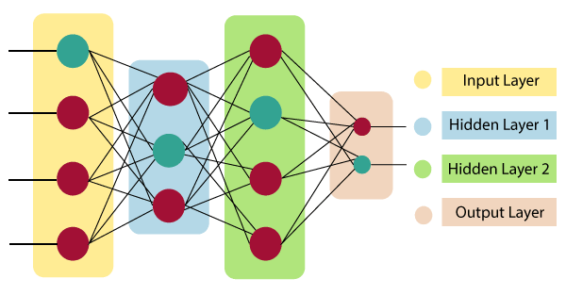
Neural Network (NN)
The term "Artificial Neural Network" is derived from Biological neural networks that develop the structure of a human brain. Similar to the human brain that has neurons interconnected to one another, artificial neural networks also have neurons that are interconnected to one another in various layers of the networks. These neurons are known as nodes.
The architecture of an artificial neural network:

Slide 20
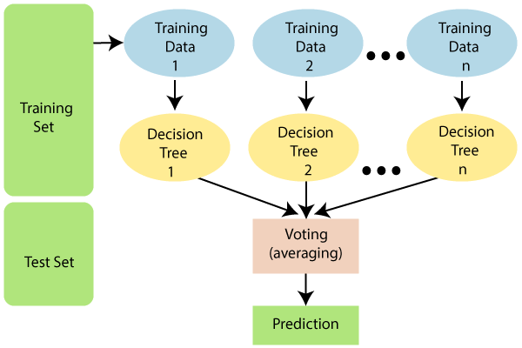
Random Forest (RF)
Random Forest is a popular machine learning algorithm that belongs to the supervised learning technique. It can be used for both Classification and Regression problems in ML. It is based on the concept of ensemble learning, which is a process of combining multiple classifiers to solve a complex problem and to improve the performance of the model.
As the name suggests, "Random Forest is a classifier that contains a number of decision trees on various subsets of the given dataset and takes the average to improve the predictive accuracy of that dataset." Instead of relying on one decision tree, the random forest takes the prediction from each tree and based on the majority votes of predictions, and it predicts the final output.

Slide 21
Tools & Technology
Programming language - Python
IDE – Visual Studio, Jupyter Notebook
Modules Imported –
1. Numpy
2. Pandas
3. Matplotlib
4. Scikit-learn
5. Keras
6. TensorFlow
7. csv
Machine Learning Algorithum – Artificial Neural Network, Random Forest, SVM etc.

Slide 22
Result Analysis
Confusion Matrix of Hybrid Model
ROC curve of Hybrid Model
Hybrid Models Comparison Graph
Performance of Hybrid Models

Slide 23
Formulas
TPR : TP/(TP+FN)
FPR : FP/(FP+TN)
TNR : TN/FP+TP)
FNR=1-TPR
Accuracy : TP+TN/(TP+TN+FN+FP)
Precision : TP/(TP+FP)
Recall : TP/(TP+FN)
F1 Score : 2*Precision*Recall/(Precision+Recall)
Error Rate : (1-Accuracy)*100

Slide 24
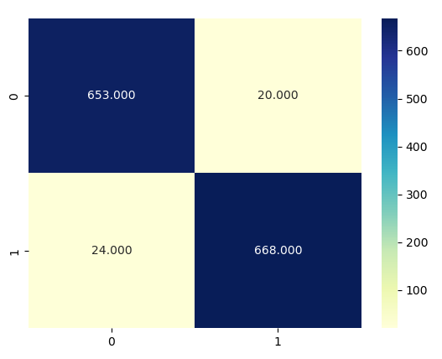
Confusion Matrix of Hybrid Model

Slide 25
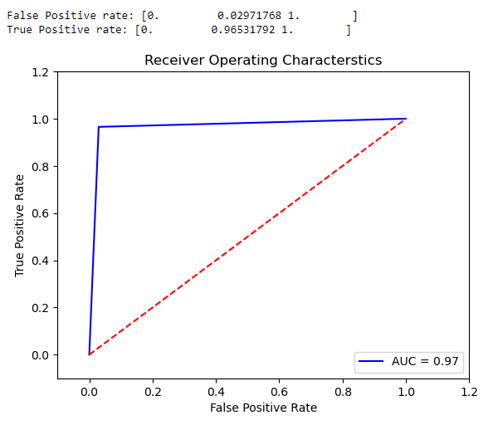
ROC curve of Hybrid Model

Slide 26
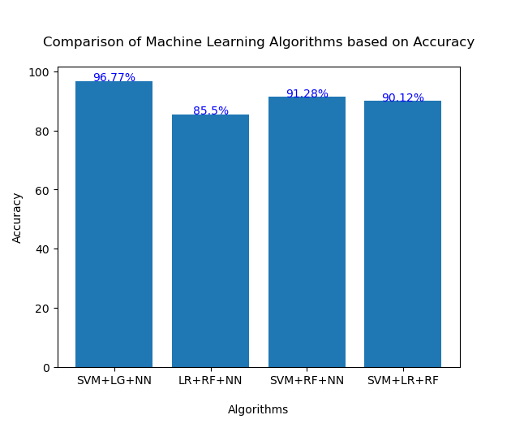
Hybrid Models Graph

Slide 27
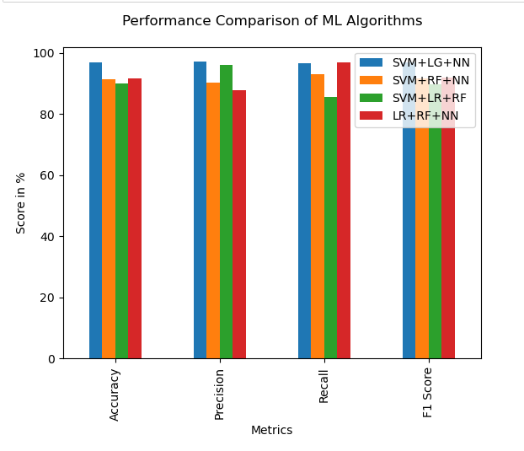
Performance of Hybrid Models

Slide 28
Conclusion
In addition to our satisfying conclusion, we have maintained the highest accuracy in detecting fake accounts by testing and training the dataset on different hybrid approach of classification algorithms. The results show the increase of the accuracy which is approx 97%.

Slide 29
THANK YOU

